Slide 1
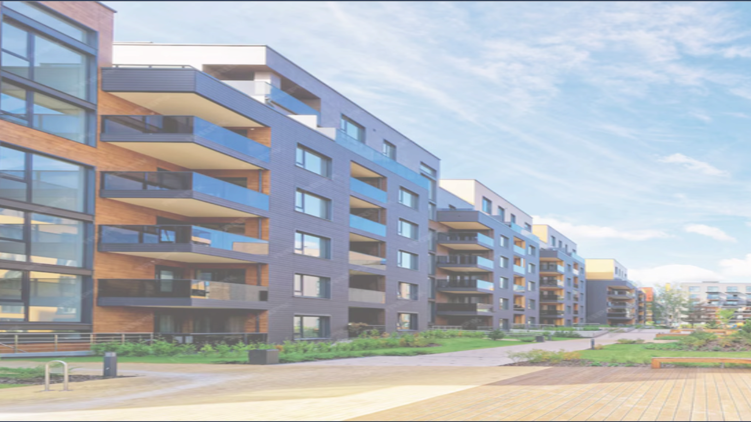
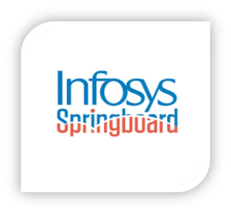
CommUnity: Seamless Community Interaction and Management
BATCH 2
Usha Sri Ponaka
Surya Sivakumar
Rupa Malika Devi D
Sanchita Mondal

Slide 2
WORK CONTRIBUTED:
Usha Sri Ponaka : Frontend and Backend
Surya Sivakumar : Backend
Rupa Malika Devi D : Frontend
Sanchita Mondal : Frontend

Slide 3
Abstract
OVERVIEW:
CommUnity is a modular, multi-tenant community management system designed to simplify housing society management. The platform connects members, streamlines daily activities, and enhances community engagement. This platform provides an efficient interface for both administrators and residents, management, facilitating interaction, and engagement within the community. For residents, Community enables communication with fellow members, access to a digital noticeboard, online bill payments, complaint submissions, event participation, and more.
Business Objectives:
· Streamline Society Operations: Enable administrators to manage residents, notices, and events efficiently.
· Improve Communication: Bridge gaps between residents and society administrators.
· Encourage Participation: Faster community interaction through events and discussions.
· Transparent Financial Management: Simplify maintenance fee collection and tracking.
· Ensure Safety: Provide easily accessible emergency and security contacts.
· Enhance Resident Engagement: Increase resident participation in community
Activities through events, polls, clubs, and social interactions.

Slide 4
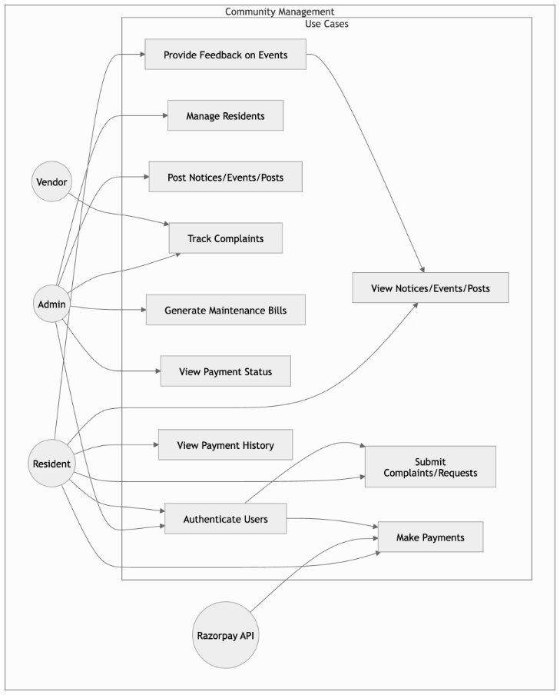
Use Case Diagram

Slide 5
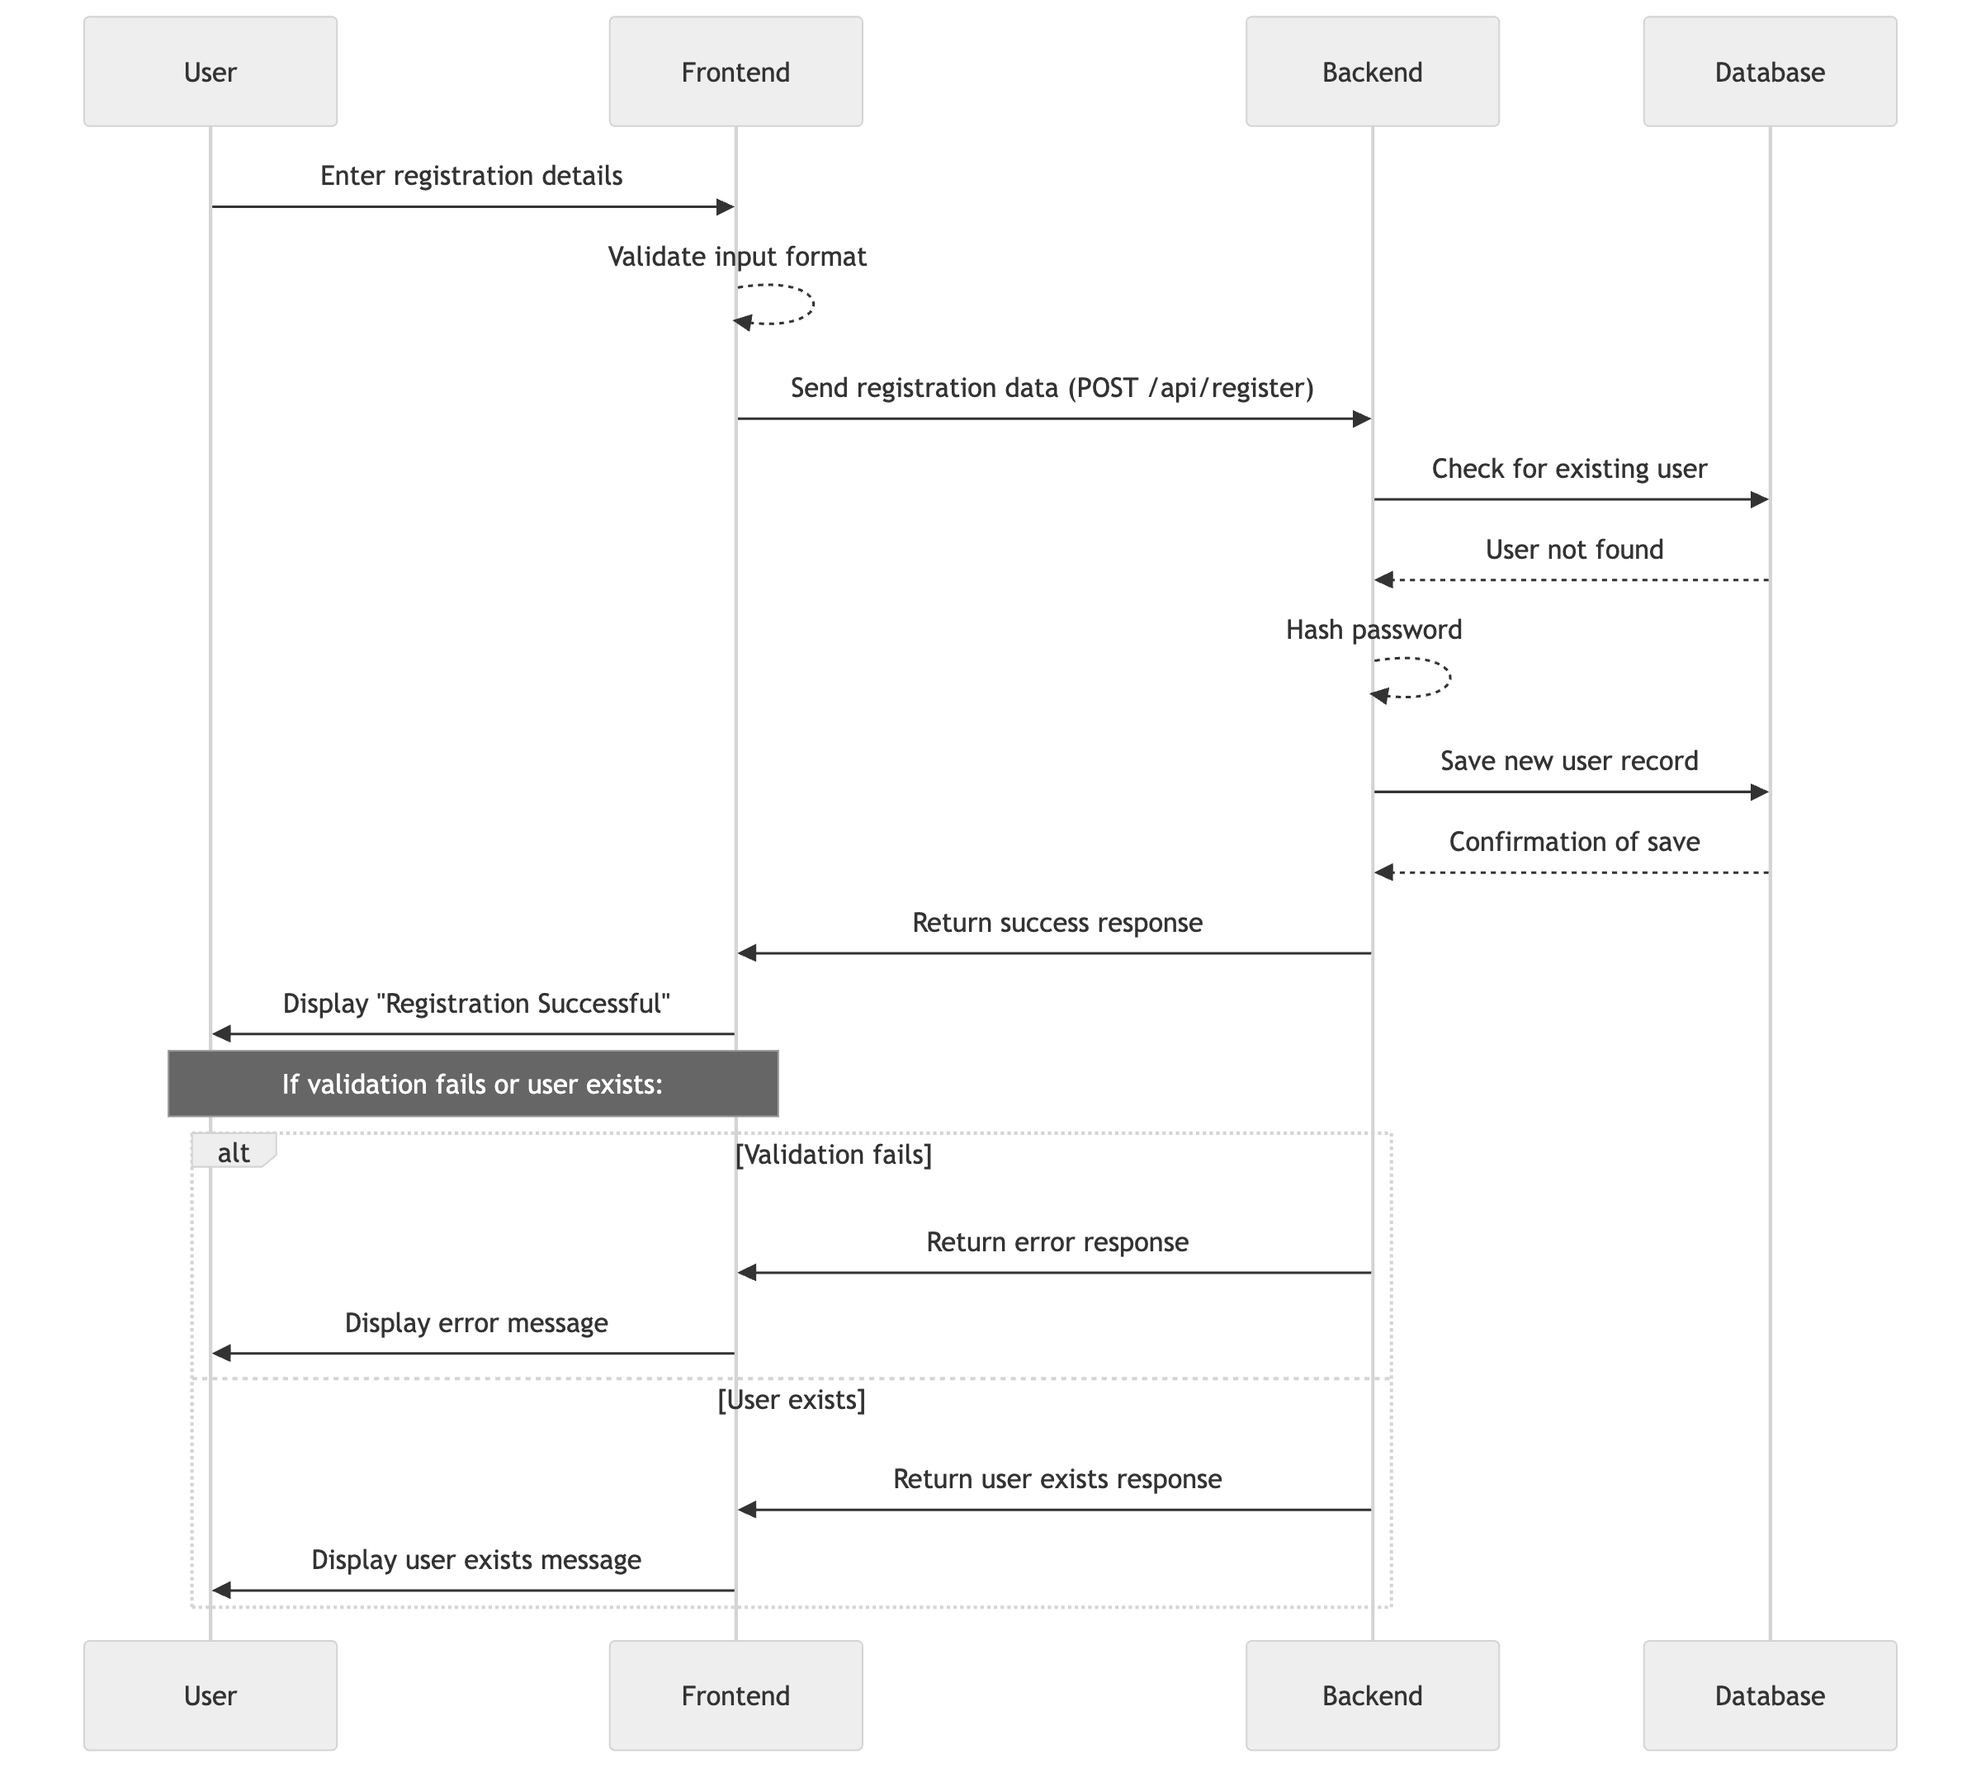
Sequence Diagram

Slide 6
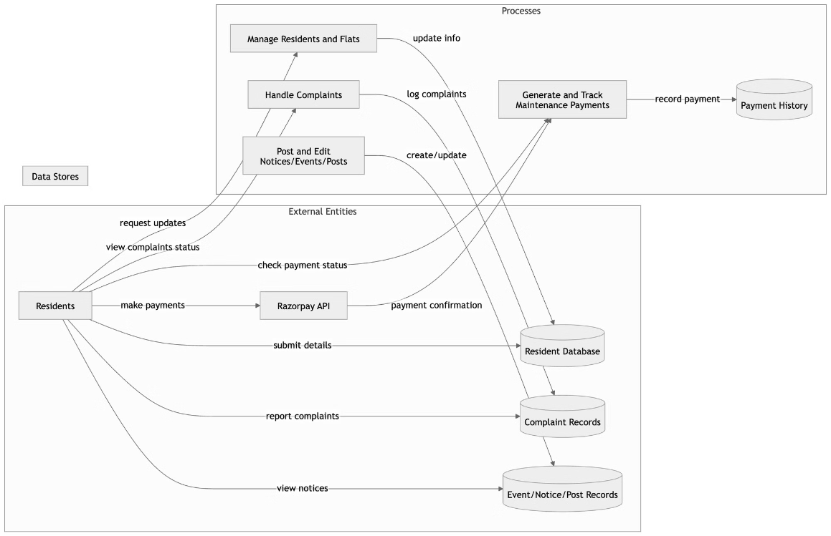
DFD Diagram For Admin

Slide 7
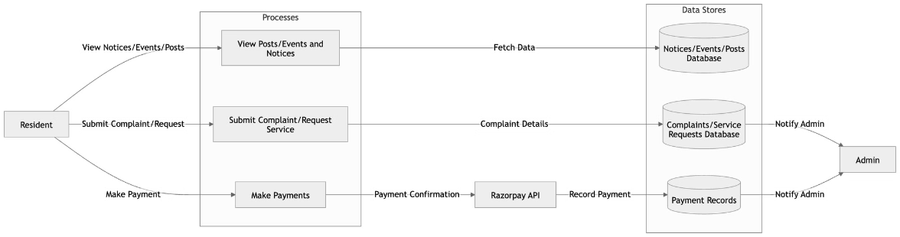
DFD Diagram for Resident

Slide 8
Modules
1
Milestone
User Authentication and Registration
2
Milestone
Resident and Society Management
3
Milestone
Event and Notice Management
Complaint and Service Request Management
4
Milestone
Maintenance Payment System

Slide 9
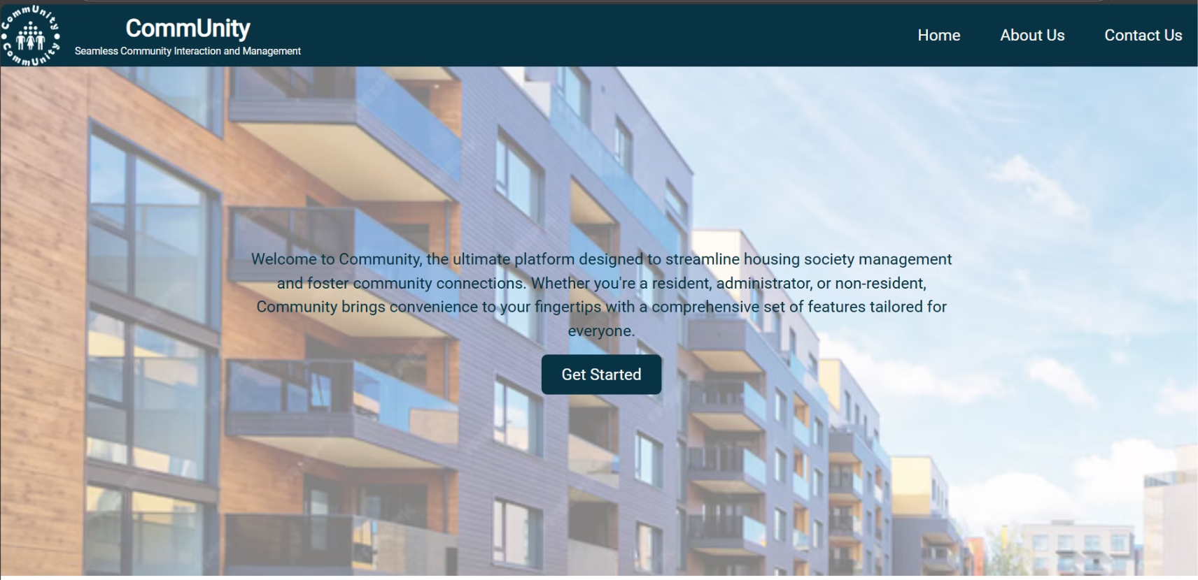

Slide 10
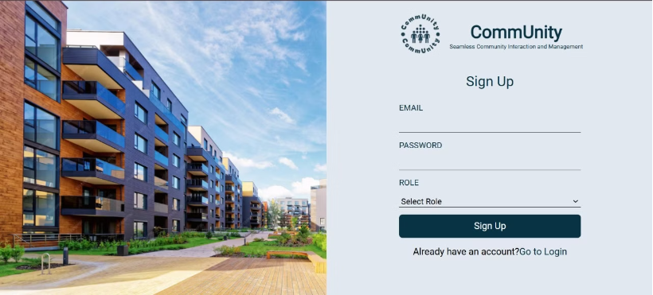
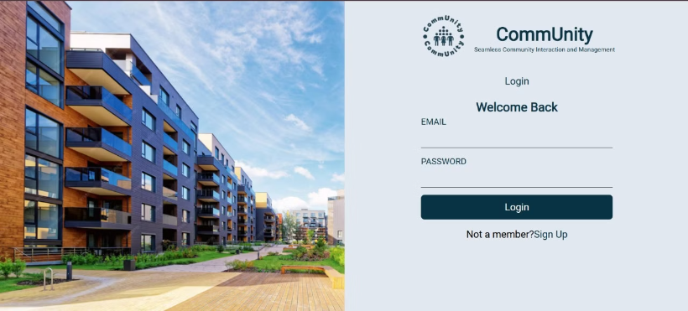
Sign Up & Login Page

Slide 11
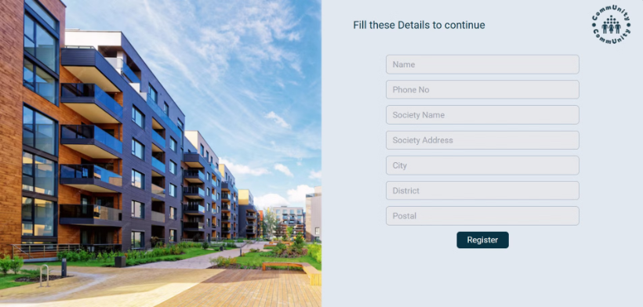
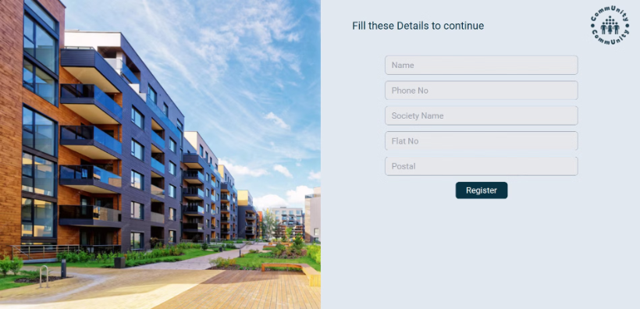
Admin & User Registration Forms
ADMIN
RESIDENT

Slide 12
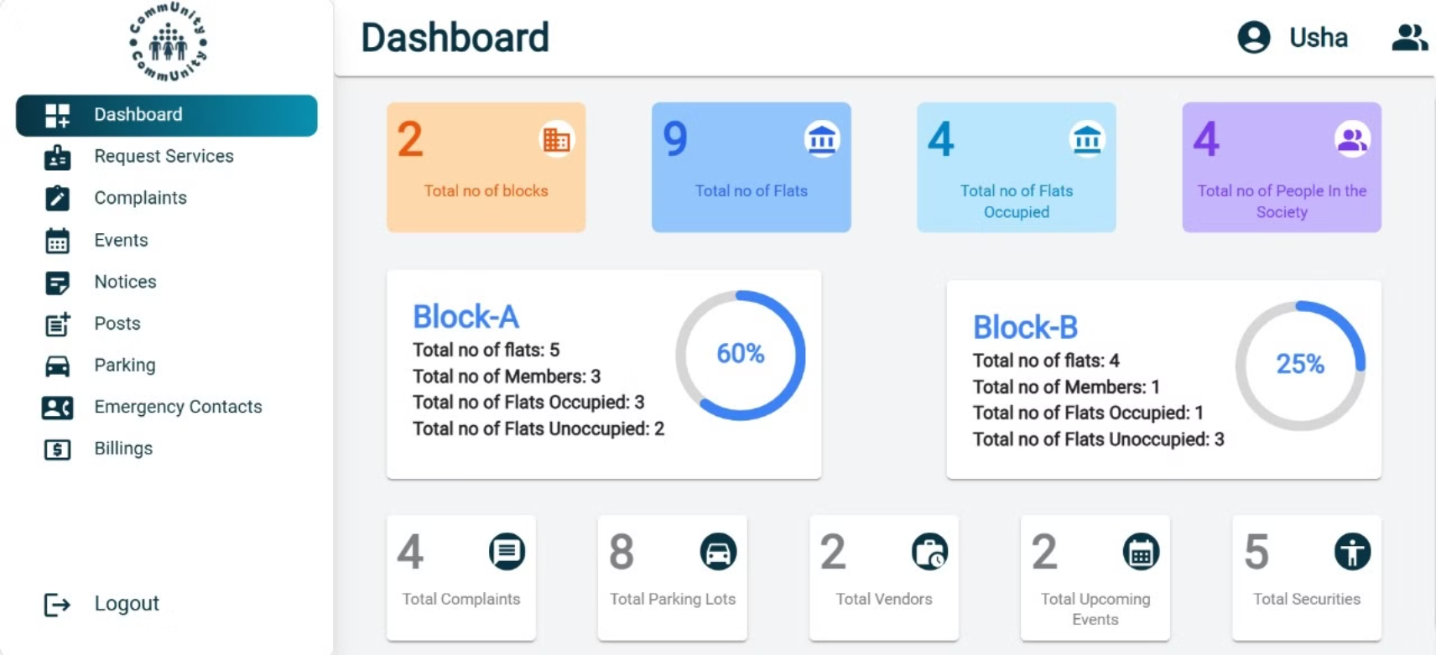

Slide 13
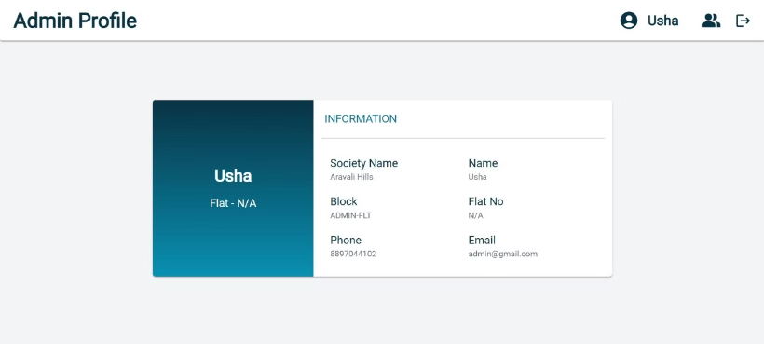
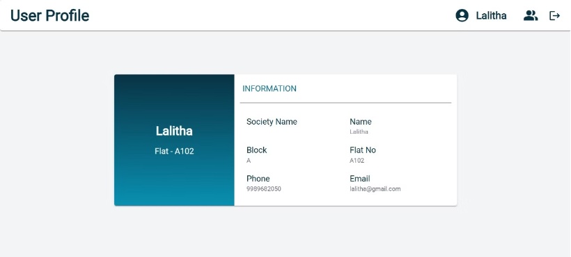
Admin & User Profile

Slide 14
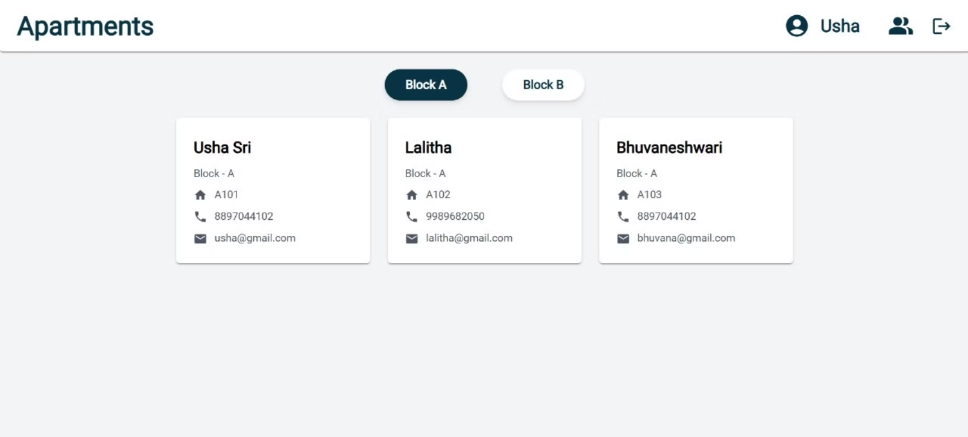

Slide 15
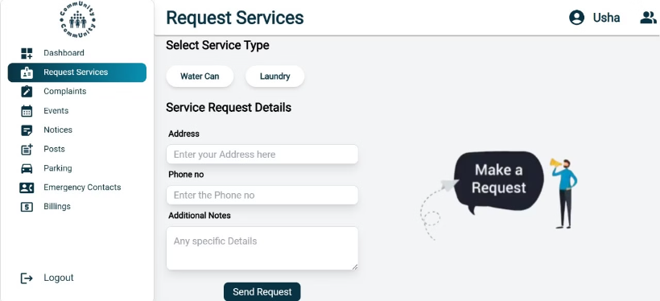
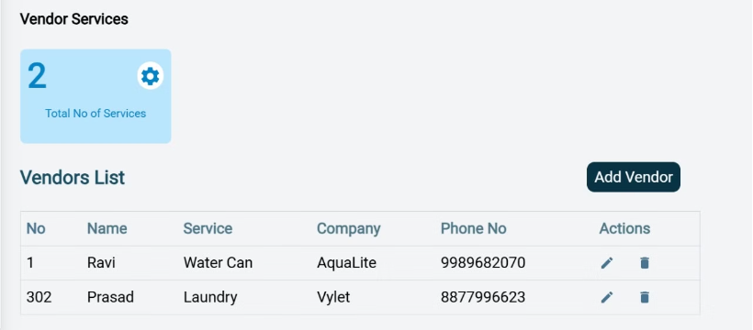
Request Services

Slide 16
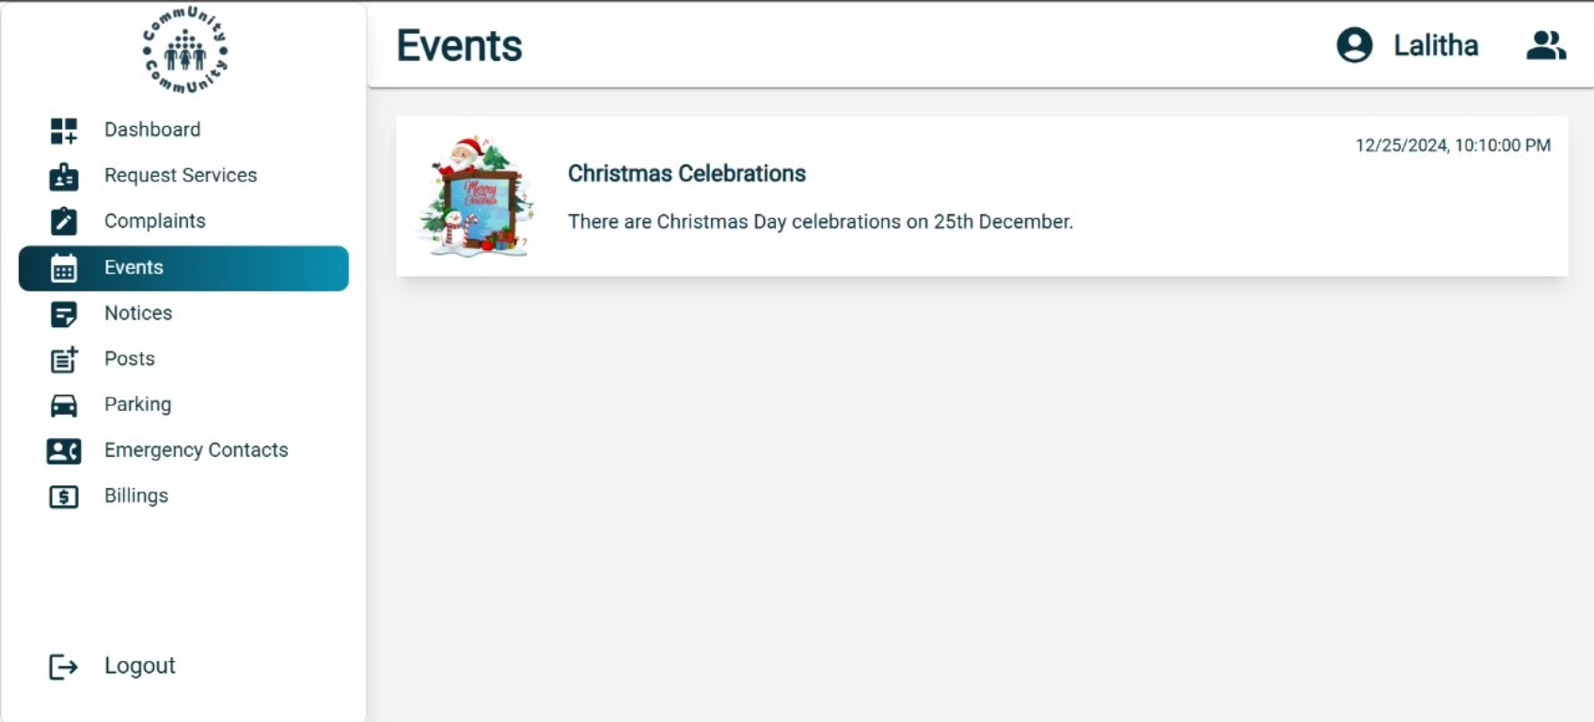
Notice Forms

Slide 17
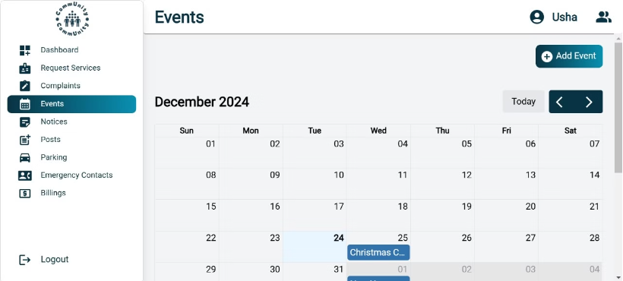
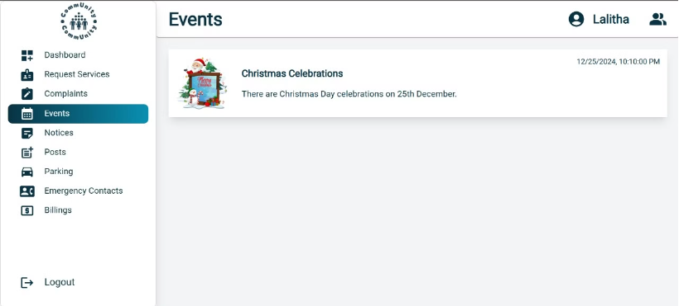
Event Forms

Slide 18
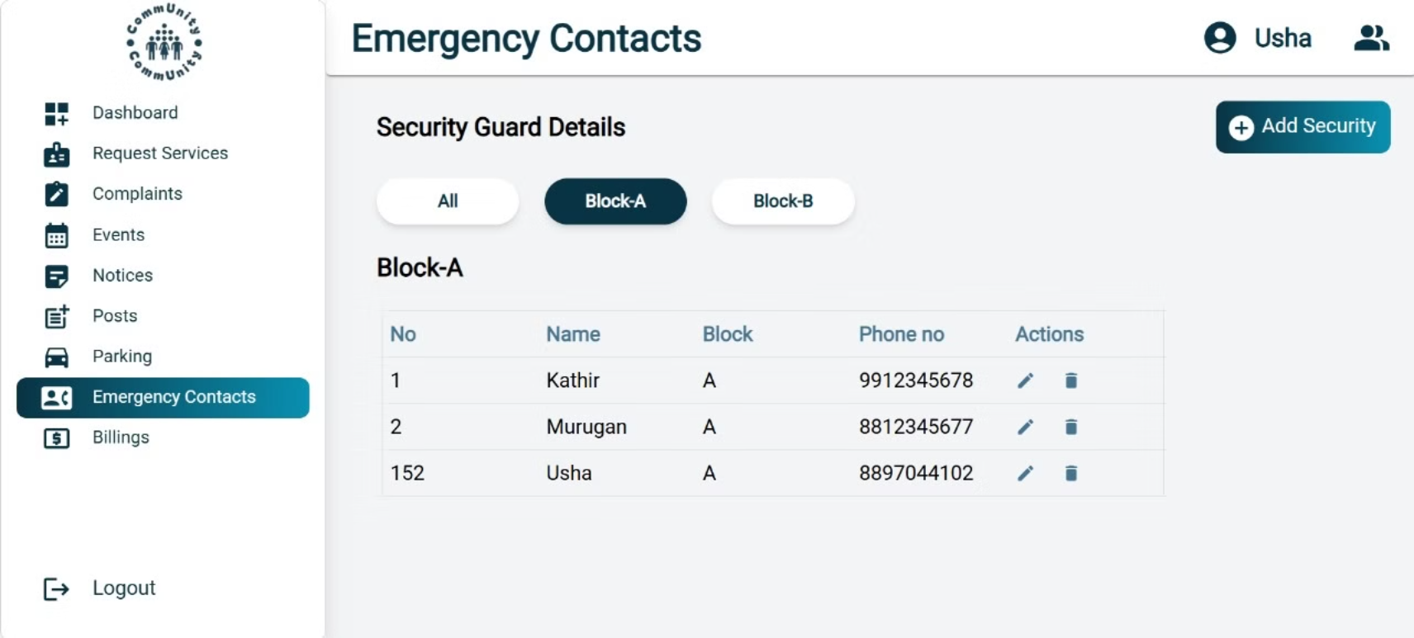

Slide 19
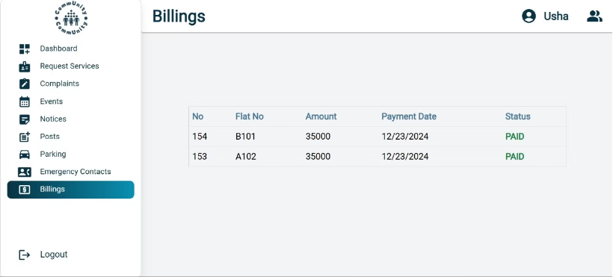
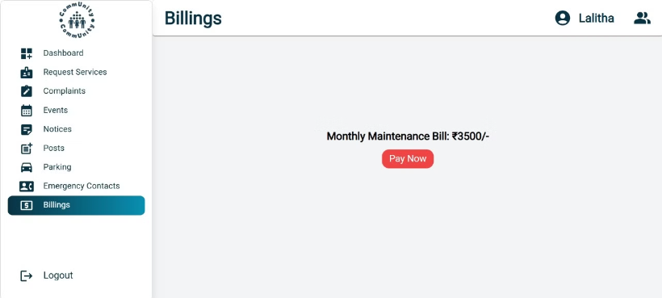
Billings

Slide 20
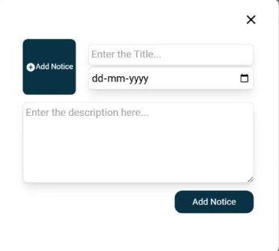

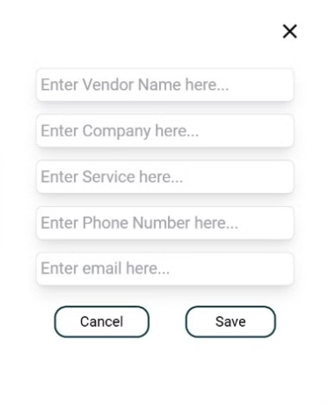
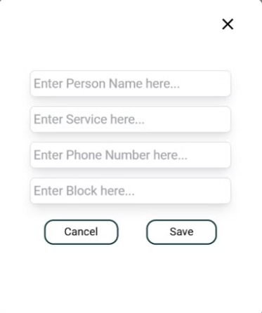
Design Forms
Notice Form
Event Form
Vendor Form
Emergency Contact Form

Slide 21

Conclusion
The "CommUnity" project successfully demonstrates a robust and modular platform for simplifying housing society management. It bridges the gap between residents and administrators, ensuring seamless communication, efficient operations, and enhanced community engagement. By implementing key modules such as user authentication, resident and society management, event and notice management, complaint handling, and an integrated maintenance payment system, the project achieves its objectives of fostering transparency, safety, and interaction.
The use of modern technologies like Razorpay integration and JWT-based authentication ensures security and convenience for users. With features like real-time updates on events, easy complaint tracking, and streamlined financial transactions, "CommUnity" sets a new standard for community management systems. This platform has the potential to be expanded further to include additional functionalities, catering to evolving community needs.
Overall, "CommUnity" proves to be an effective solution for enhancing the quality of life in housing societies and encouraging an active, connected, and well-managed community environment.

